Slide 1
Speaker Recognition
Group 9:
Justin Nguyen 30042258
Lukas Morrison 30038720

Slide 2
Project Flow
Feature Extraction
Statistical Models
GMM Training
Mean
Training Set
Cepstrum
Variance
GMM Classification
Weight
Training Models
Test Set
Cepstrum
Similarity Scores

Slide 3
Dataset
Training
Four subjects
Average 40 second sound file
Same long paragraph across subjects
Testing
Six subjects, two are not in the training set
Average 12 second sound file
Same short paragraph across subjects

Slide 4
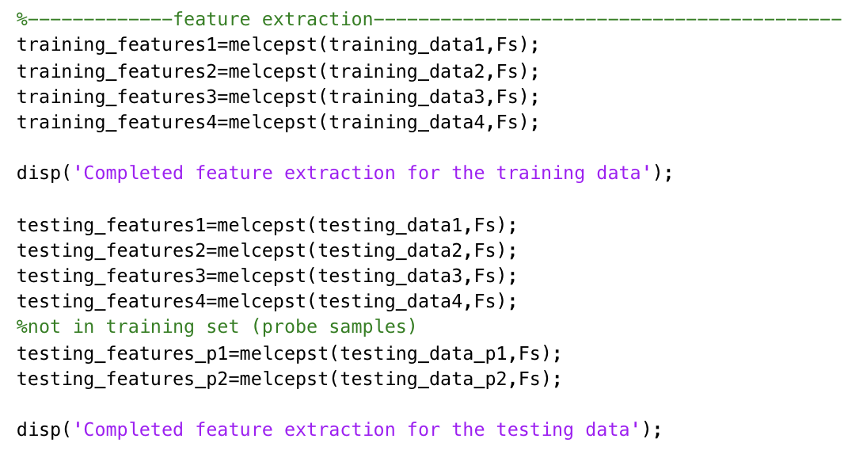

Feature Extraction
MELCEPST.m
Input 1: speech signal obtained from audioread()
Input 2: sample rate (8000 Hz)
Based on audio file

Slide 5
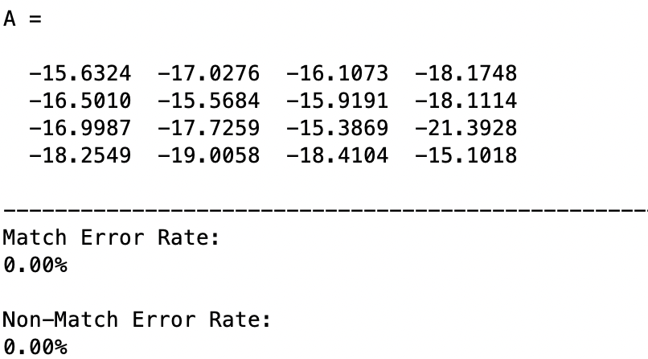
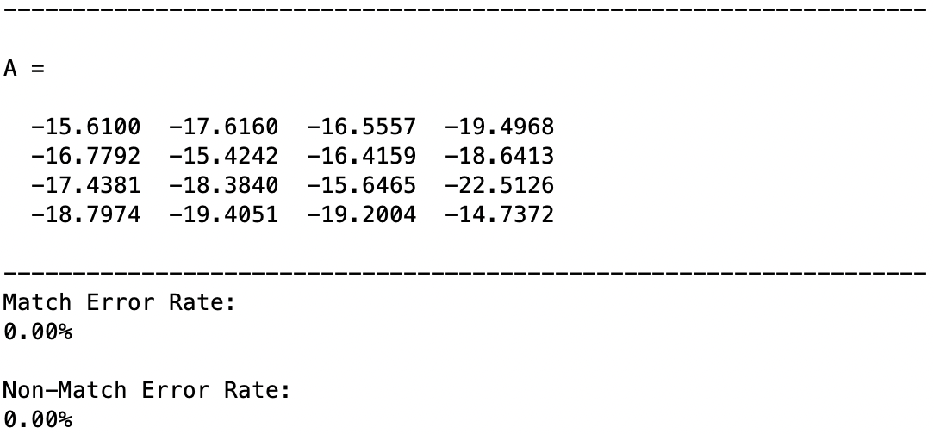
GMM Training
Number of Gaussian Components = 10
Number of Gaussian Components = 50
GMM_ESTIMATE.m
Input 1: feature extraction from speech signal
Input 2: number of Gaussian components (50)
Greater number of components results in greater differential between scores
Notes:
GMM Training was used using the provided gmm_estimate file where the first input was the features we extracted from our speech signals, and the second input was the number of Gaussian components we used. The number of components we used was 50 as it provided a greater differential between scores than 10 as you can see here.
This increased the accuracy of the system to a point we felt comfortable that we wouldn’t get any false positives. We found that increasing it any higher than this wouldn’t necessarily result in a greater difference as the scores change.

Slide 6
Classification & Validation
Dataset Samples
Confusion Matrix
Scores
Error Rate
Threshold: -15.7
Notes:
Here are our scores and the confusion matrix for our 4 subjects in the training set. The higher the score, the lighter the colour is, and as you can see here, the diagonal is the lightest colour in each of the 4 rows representing the true matches. From these scores, we chose a threshold of -15.7 and calculated our match and non-match error rates off of that.

Slide 7
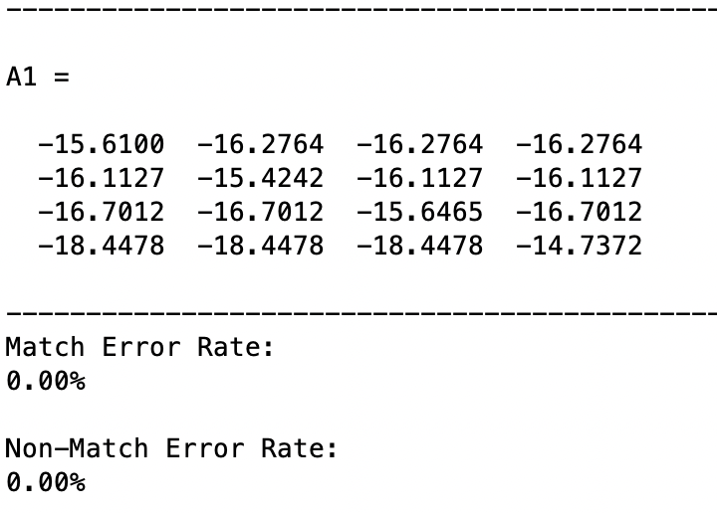
Classification & Validation
First Probe Sample
Confusion Matrix
Scores
Error Rate
Threshold: -15.7
Notes:
Next, here are our scores and the confusion matrix for our first probe sample who was not in the training set. We represented this in the same 4x4 confusion matrix where the diagonal represents the true matches. Every other box here represents the probe sample being tested against each subject in the training set. We did this to visualize the difference between the true matches and the true non-matches.

Slide 8
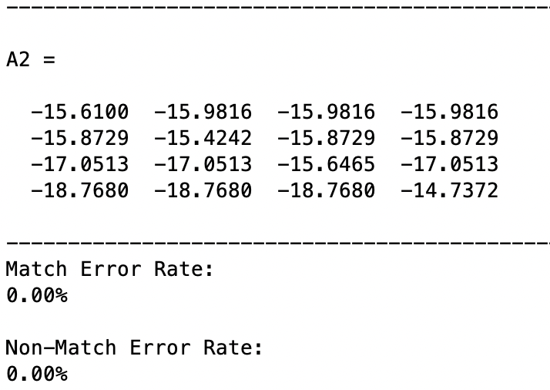
Classification & Validation
Second Probe Sample
Confusion Matrix
Scores
Error Rate
Threshold: -15.7
Notes:
Finally, here is our second probe sample who was also not in the training set and the results are the same. We can see that the system is able to correctly recognize different speakers.

Slide 9

Questions & Answers
Notes:
That concludes our presentation, and thank you for listening. Are there any questions?

